Slide 1

WEB SCRAPING TO GAIN COMPANY INSIGHTS
FOR PURPOSES OF FORAGE VIRTUAL WORK EXPERIENCE PROGRAM
MADE BY:
IRA SAFONIK
22.04.2024

Slide 2
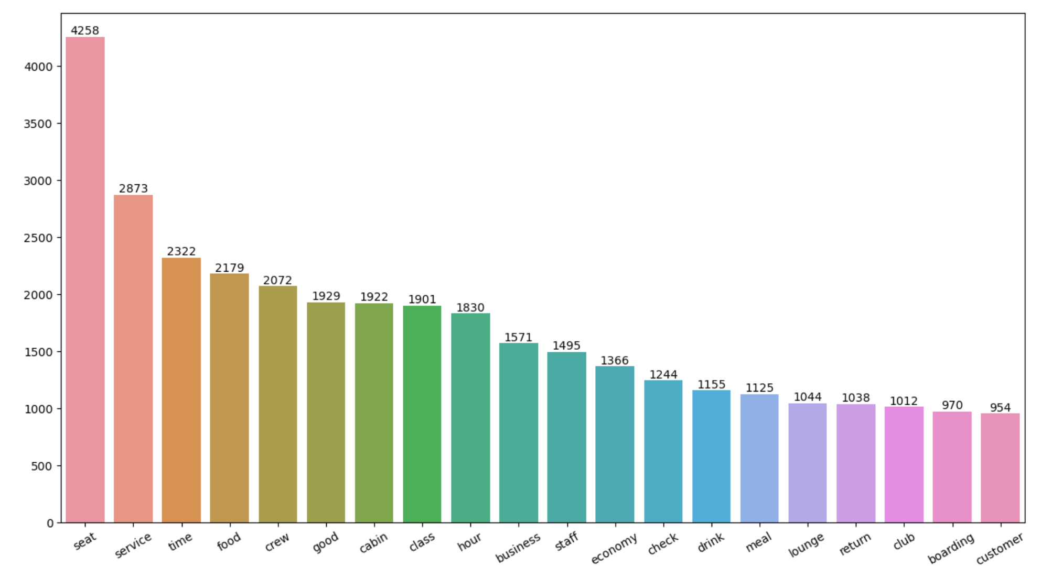
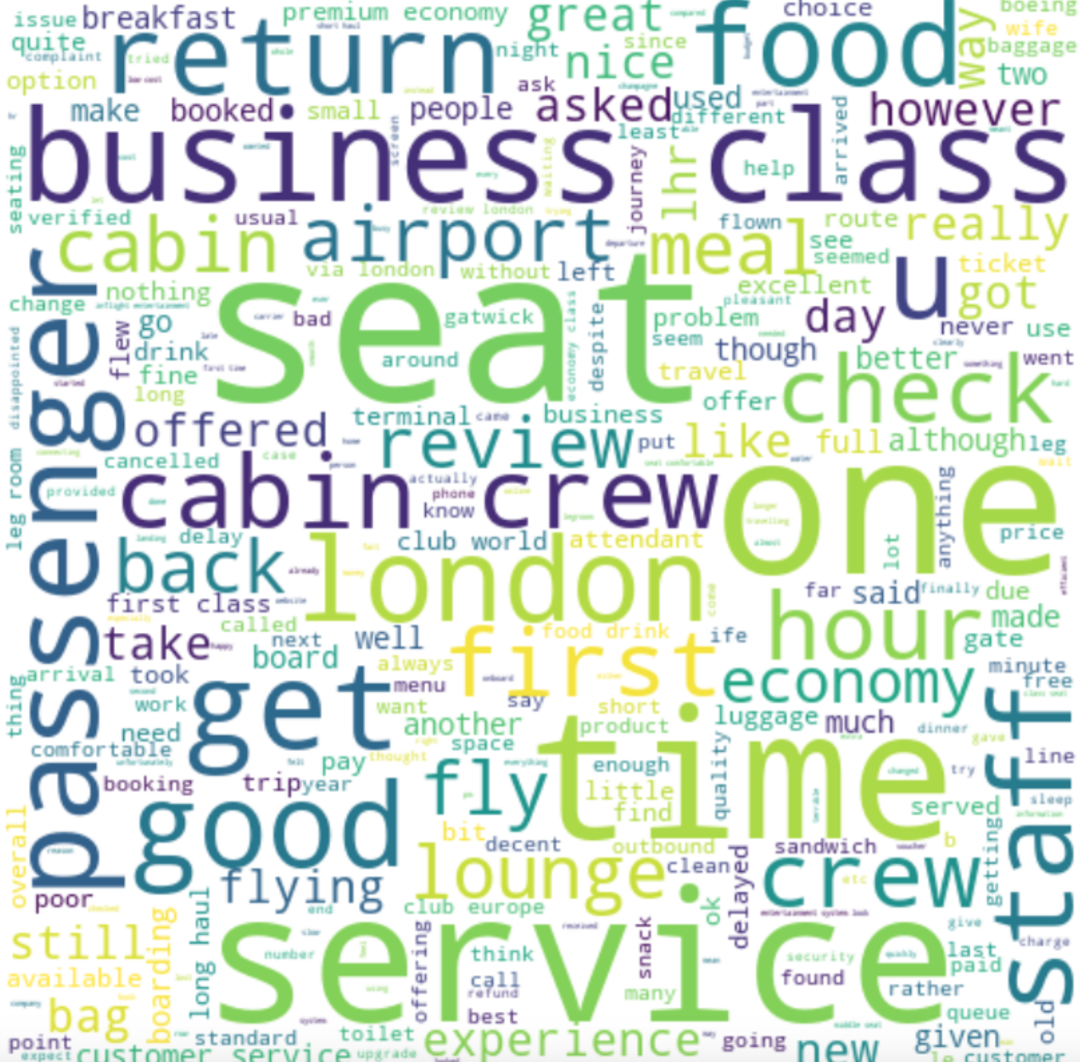
INSIGHTS FROM CUSTOMER REVIEWS - Key Topics
The findings reveal that customers are actively discussing several key topics in their reviews. "Seat" stands out as the predominant subject, trailed by "Service", "Time," and "Food", all integral elements of the customer experience.

Slide 3
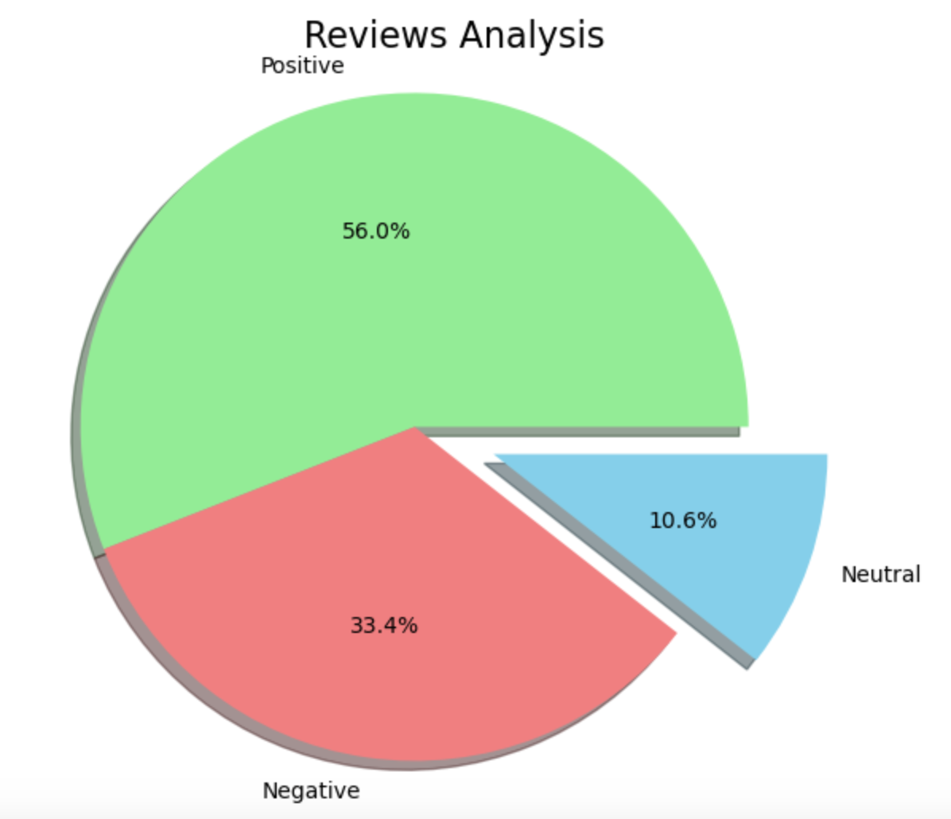
INSIGHTS FROM CUSTOMER REVIEWS - Sentiment
The obtained analysis results show that out of 3 500 airline reviews.
The majority are positive (1 956), while less than a third of the reviews are negative (1 169). Only 370 of the reviews are neutral.
56%
positive
33.4%
negative
10.6%
neutral

